Slide 2
Announcements

Slide 3

CS 370: Artificial Intelligence
Constraint Satisfaction Problems
Instructor: William DeMeo
Slides by Dan Klein and Pieter Abbeel University of California, Berkeley

Slide 4

What is Search For?
Assumptions about the world: a single agent, deterministic actions, fully observed state, discrete state space
Planning: sequences of actions
The path to the goal is the important thing
Paths have various costs, depths
Heuristics give problem-specific guidance
Identification: assignments to variables
The goal itself is important, not the path
All paths at the same depth (for some formulations)
CSPs are a specialized class of identification problems

Slide 5

Constraint Satisfaction Problems

Slide 6

Constraint Satisfaction Problems
Standard search problems:
State is a “black box”: arbitrary data structure
Goal test can be any function over states
Successor function can also be anything
Constraint satisfaction problems (CSPs):
A special subset of search problems
State is defined by variables X_{i} with values from a domain D (sometimes D depends on i)
Goal test is a set of constraints specifying allowable combinations of values for subsets of variables
Simple example of a formal representation language
Allows useful general-purpose algorithms with more power than standard search algorithms

Slide 7
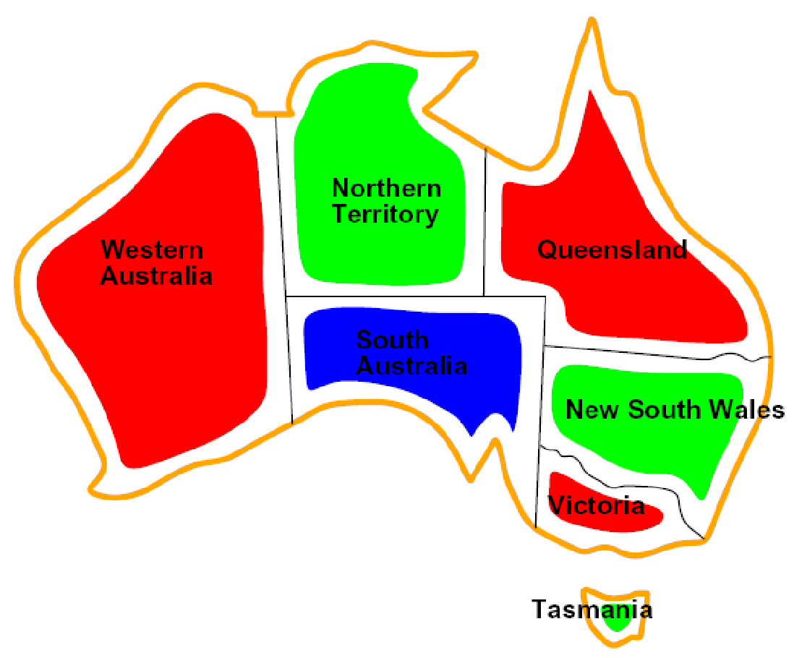
CSP Examples

Slide 8


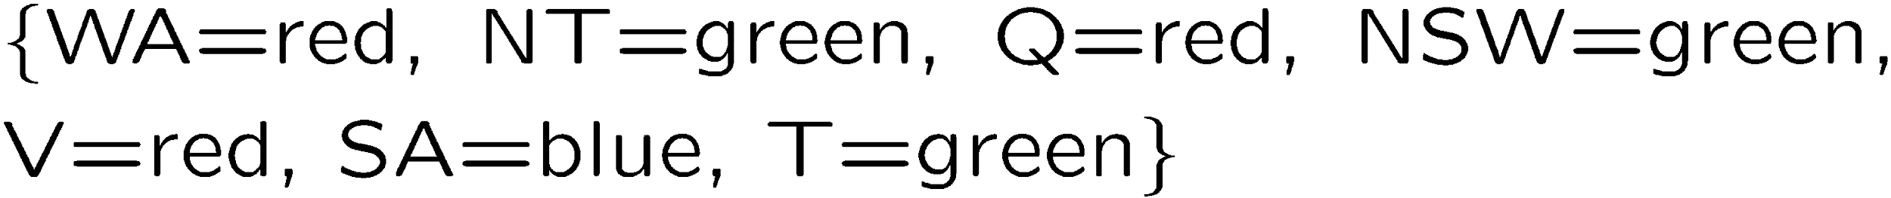
Example: Map Coloring
Variables:
Domain:
Constraints: adjacent regions must have different colors
Solutions are assignments satisfying all constraints, e.g.:
Implicit:
Explicit:

Slide 9

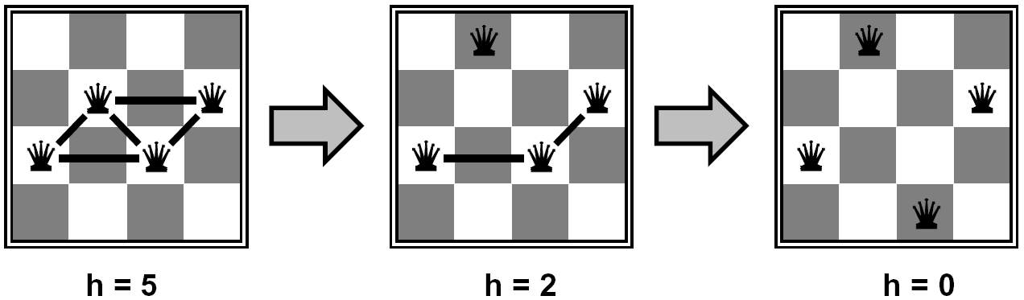
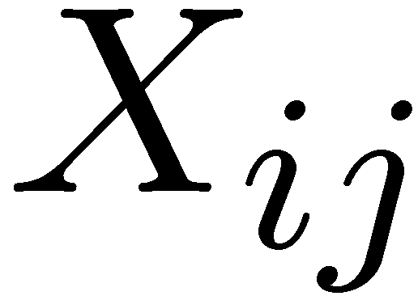

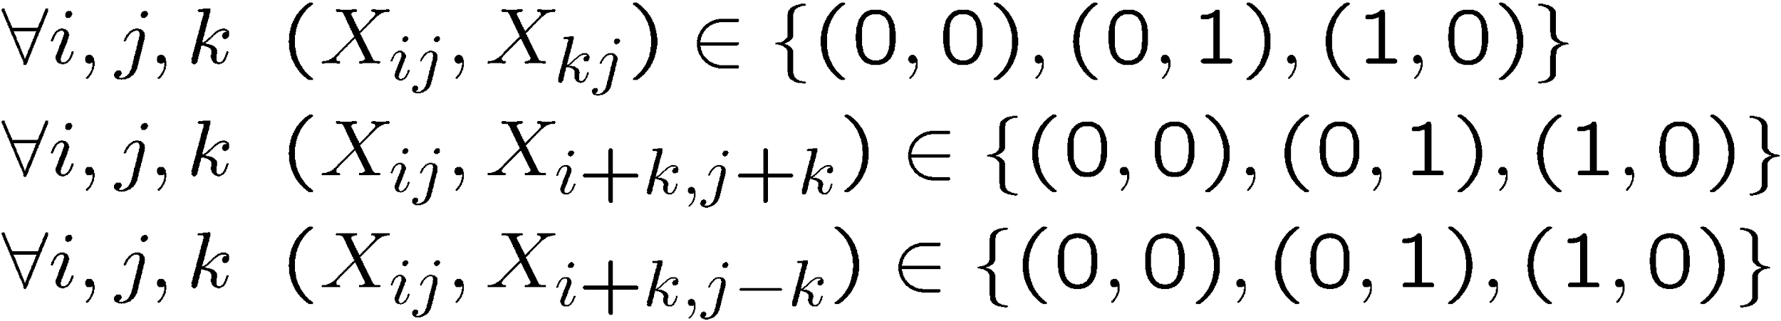
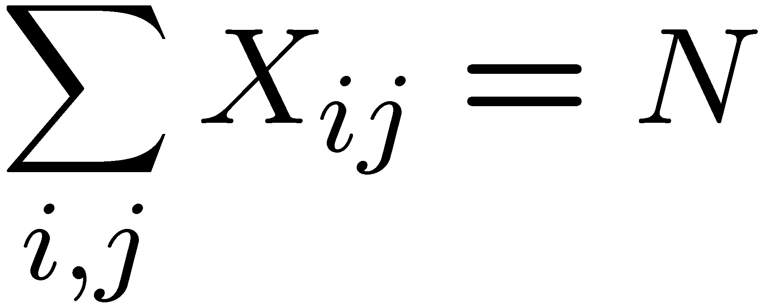
Example: N-Queens
Formulation 1:
Variables:
Domain:
Constraints

Slide 10







Example: N-Queens
Formulation 2:
Variables:
Domain:
Constraints:
Implicit:
Explicit:

Slide 11
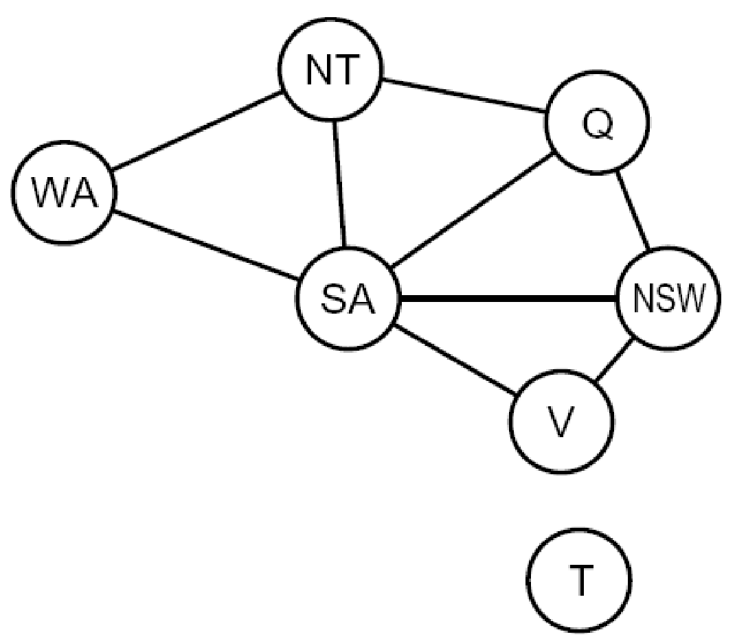
Constraint Graphs

Slide 12
Constraint Graphs
Binary CSP: each constraint relates (at most) two variables
Binary constraint graph: nodes are variables, arcs show constraints
General-purpose CSP algorithms use the graph structure to speed up search. E.g., Tasmania is an independent subproblem!
[Demo: CSP applet (made available by aispace.org) -- n-queens]
Notes:
Demo:
Run constraint.jar or constraint.exe, load the 5 queens problem.
Demo is just showing the n-queens applet as illustration of constraint graph, but later in lecture we’ll interact with the applet.
aispace.org will have the latest version

Slide 13
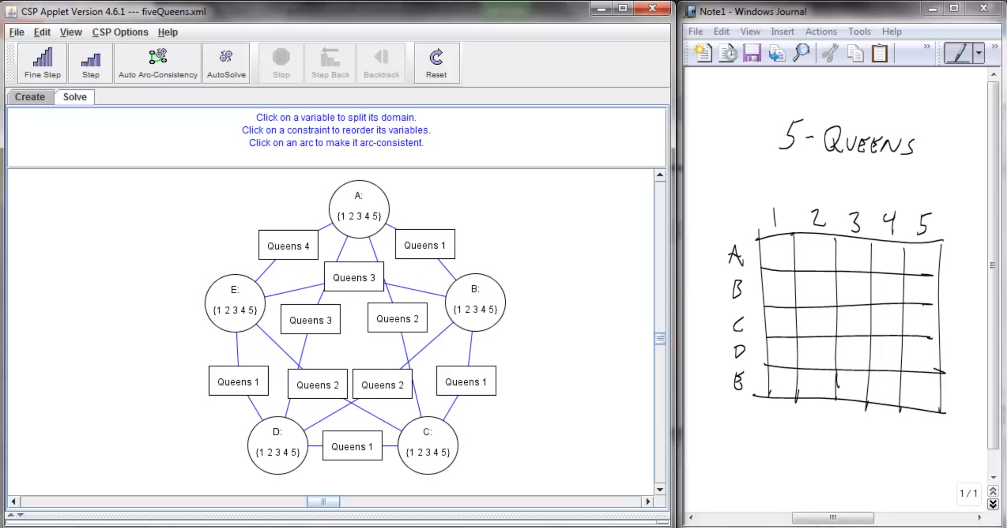
Screenshot of Demo N-Queens
Notes:
Note: the n-queens demo is used later as a demo; at this stage in lecture just the above is shown and talked about without engaging in any interaction with the applet.

Slide 14

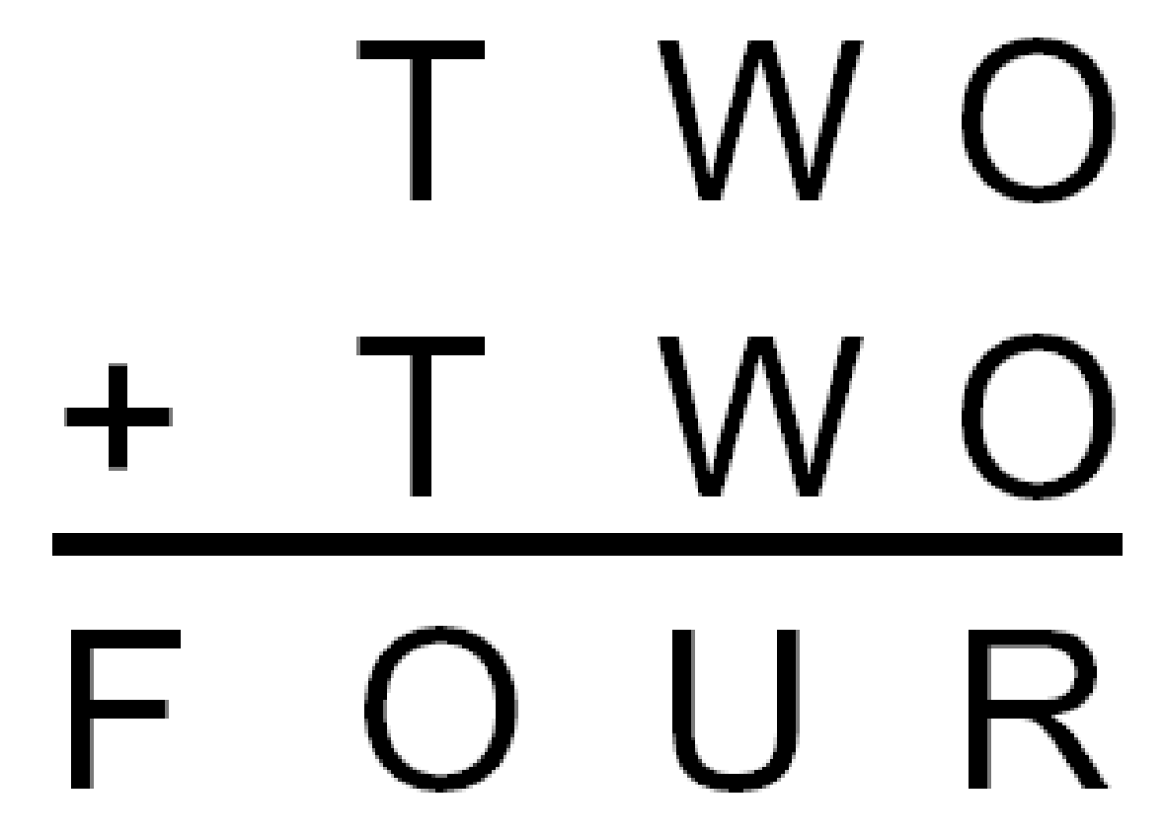
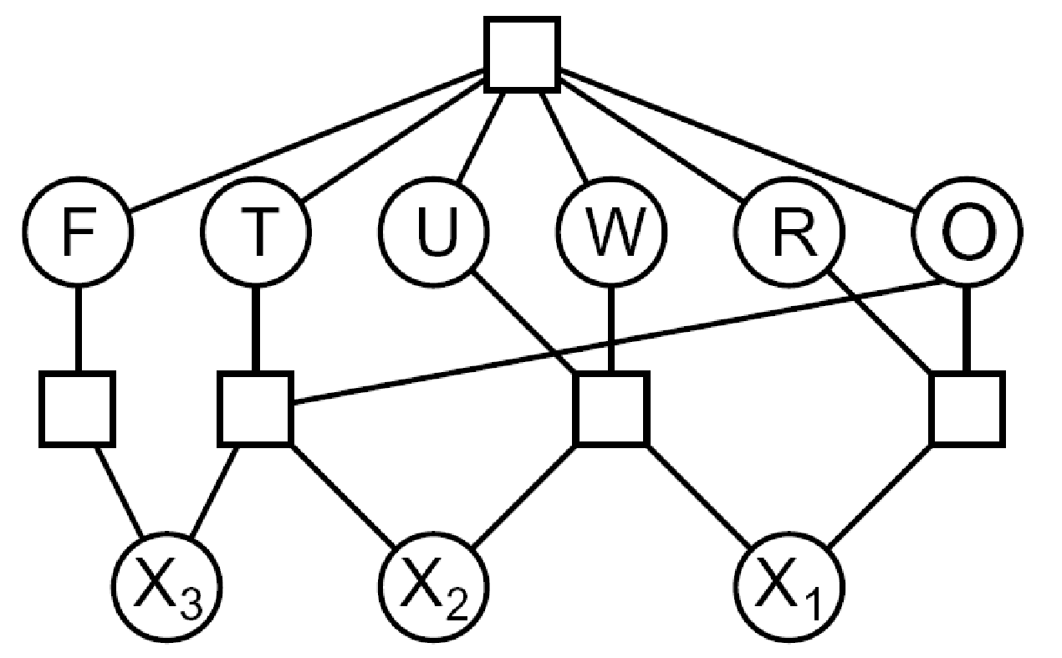

Example: Cryptarithmetic
Variables:
Domain:
Constraints:
Notes:
0=7, R=4, W=6, U=2, T=8, F=1; 867 + 867 = 1734

Slide 15
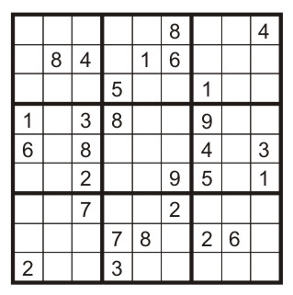
Example: Sudoku
Variables:
Each (open) square
Domain:
{1,2,…,9}
Constraints:
9-way alldiff for each column
9-way alldiff for each row
9-way alldiff for each region
(or can have a bunch of pairwise inequality constraints)

Slide 16


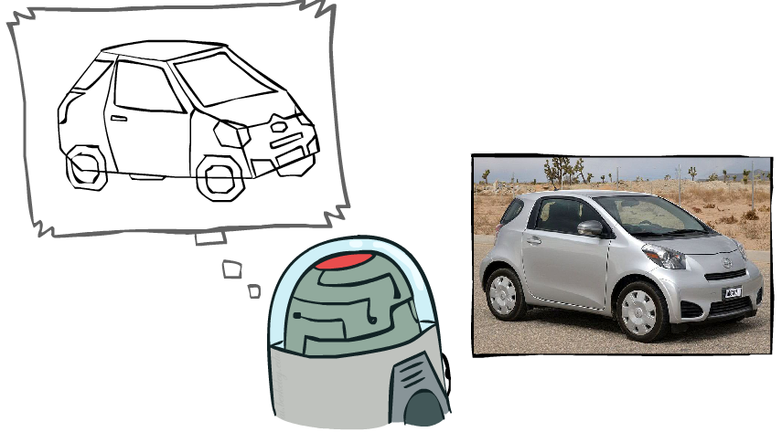
Example: The Waltz Algorithm
The Waltz algorithm is for interpreting line drawings of solid polyhedra as 3D objects
An early example of an AI computation posed as a CSP
?
Approach:
Each intersection is a variable
Adjacent intersections impose constraints on each other
Solutions are physically realizable 3D interpretations

Slide 17

Varieties of CSPs and Constraints

Slide 18

Varieties of CSPs
Discrete Variables
Finite domains
Size d means O(d^{n}) complete assignments
E.g., Boolean CSPs, including Boolean satisfiability (NP-complete)
Infinite domains (integers, strings, etc.)
E.g., job scheduling, variables are start/end times for each job
Linear constraints solvable, nonlinear undecidable
Continuous variables
E.g., start/end times for Hubble Telescope observations
Linear constraints solvable in polynomial time by LP methods (see cs170 for a bit of this theory)

Slide 19


Varieties of Constraints
Varieties of Constraints
Unary constraints involve a single variable (equivalent to reducing domains), e.g.:
Binary constraints involve pairs of variables, e.g.:
Higher-order constraints involve 3 or more variables:
e.g., cryptarithmetic column constraints
Preferences (soft constraints):
E.g., red is better than green
Often representable by a cost for each variable assignment
Gives constrained optimization problems
(We’ll ignore these until we get to Bayes’ nets)

Slide 20
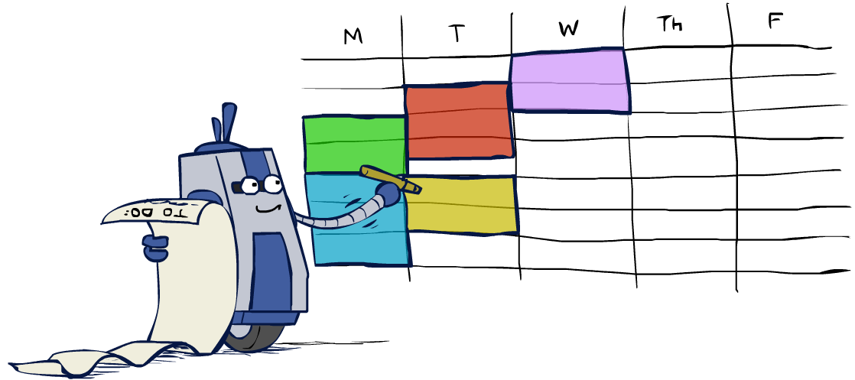
Real-World CSPs
Scheduling problems: e.g., when can we all meet?
Timetabling problems: e.g., which class is offered when and where?
Assignment problems: e.g., who teaches what class
Hardware configuration
Transportation scheduling
Factory scheduling
Circuit layout
Fault diagnosis
… lots more!
Many real-world problems involve real-valued variables…

Slide 21

Solving CSPs

Slide 22
Standard Search Formulation
Standard search formulation of CSPs
States defined by the values assigned so far (partial assignments)
Initial state: the empty assignment, {}
Successor function: assign a value to an unassigned variable
Goal test: the current assignment is complete and satisfies all constraints
We’ll start with the straightforward, naïve approach, then improve it

Slide 23
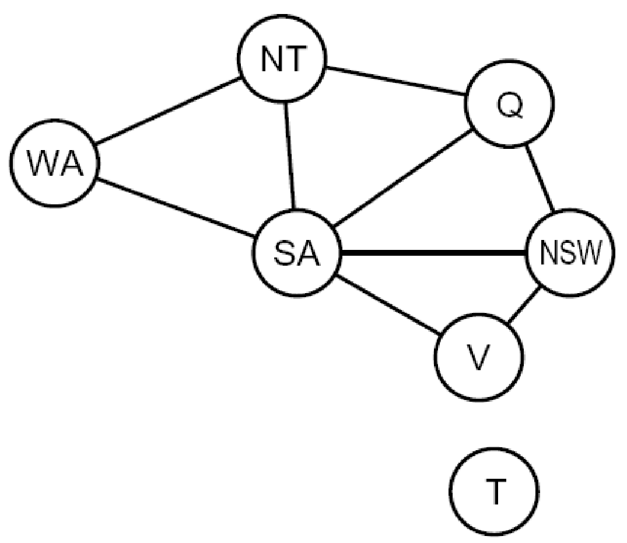
Search Methods
What would BFS do?
What would DFS do?
What problems does naïve search have?
[Demo: coloring -- dfs]
Notes:
Demo:
CS188 javascript demos -> source -> exercises -> csps -> CSPs demos -> CSPs demos.html
Settings:
Graph = Simple
Algorithm = Naïve Search
Ordering = None
Filtering = None

Slide 24

Video of Demo Coloring -- DFS

Slide 25

Backtracking Search

Slide 26
Backtracking Search
Backtracking search is the basic uninformed algorithm for solving CSPs
Idea 1: One variable at a time
Variable assignments are commutative, so fix ordering
I.e., [WA = red then NT = green] same as [NT = green then WA = red]
Only need to consider assignments to a single variable at each step
Idea 2: Check constraints as you go
I.e. consider only values which do not conflict with previous assignments
Might have to do some computation to check the constraints
“Incremental goal test”
Depth-first search with these two improvements
is called backtracking search (not the best name)
Can solve n-queens for n ≈ 25

Slide 27
Video of Demo Coloring – Backtracking

Slide 28

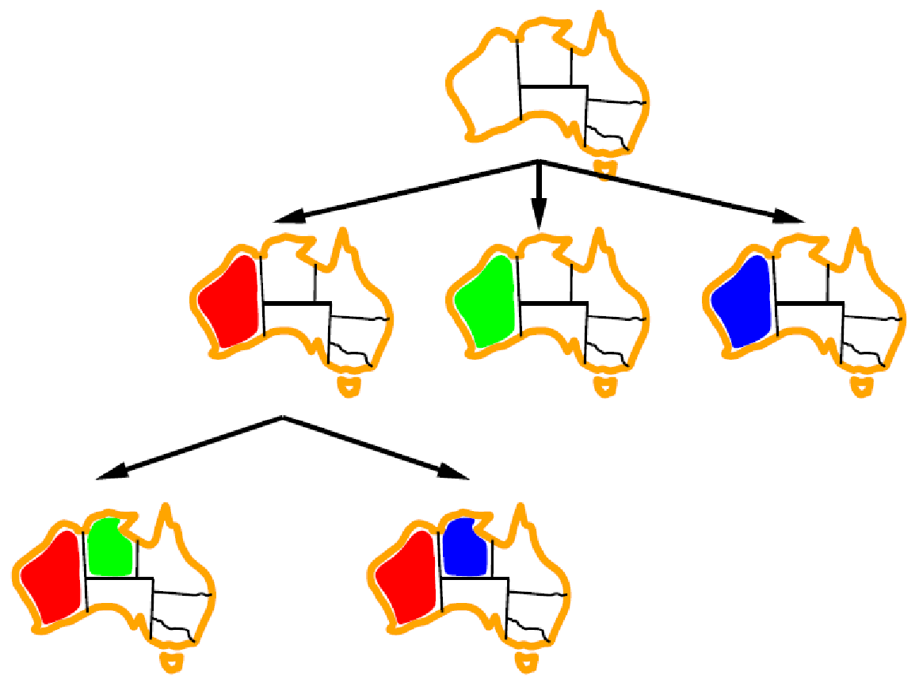
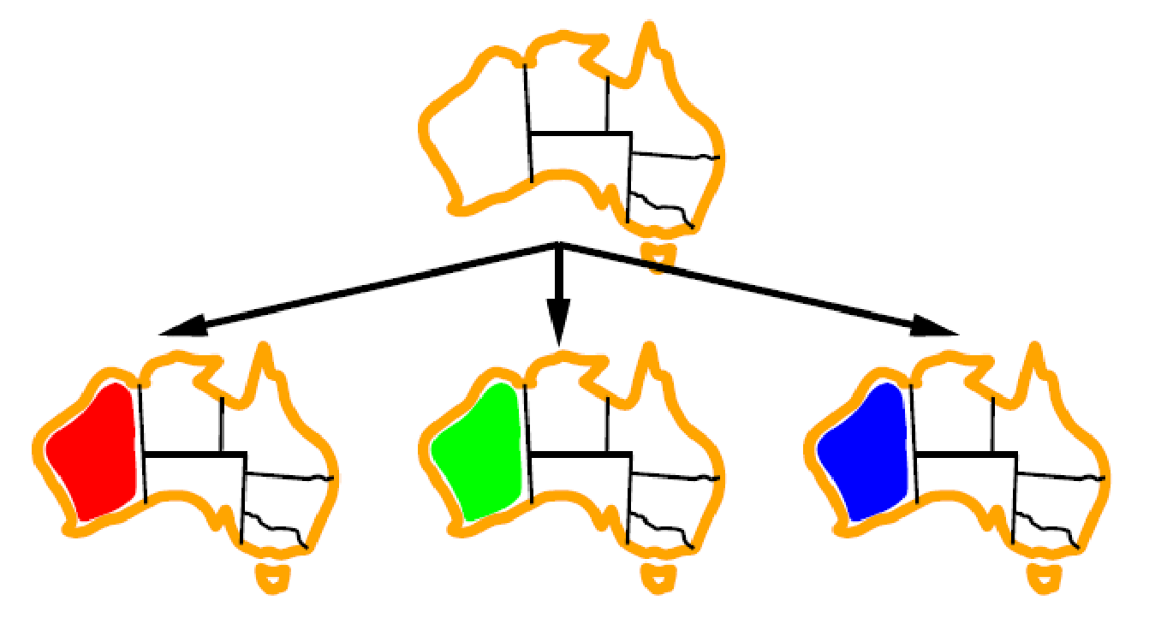
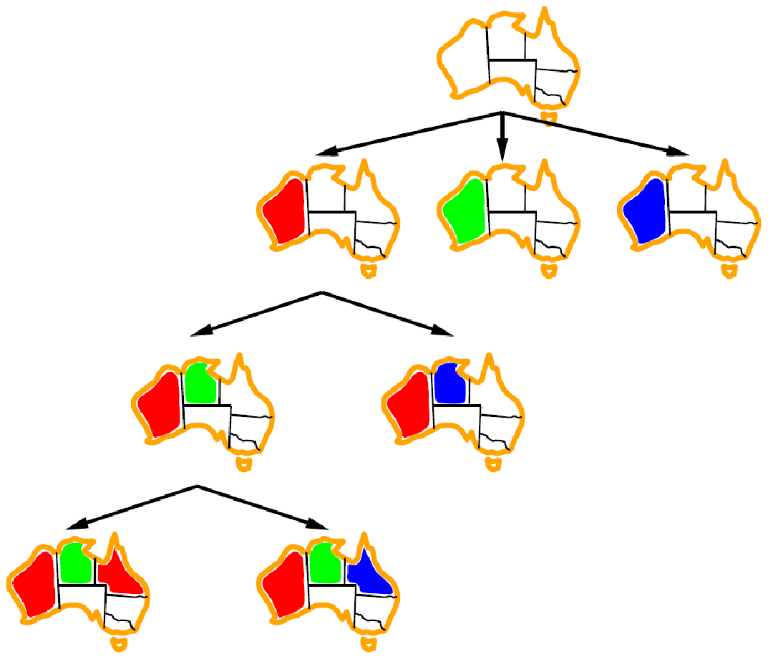
Backtracking Example

Slide 29
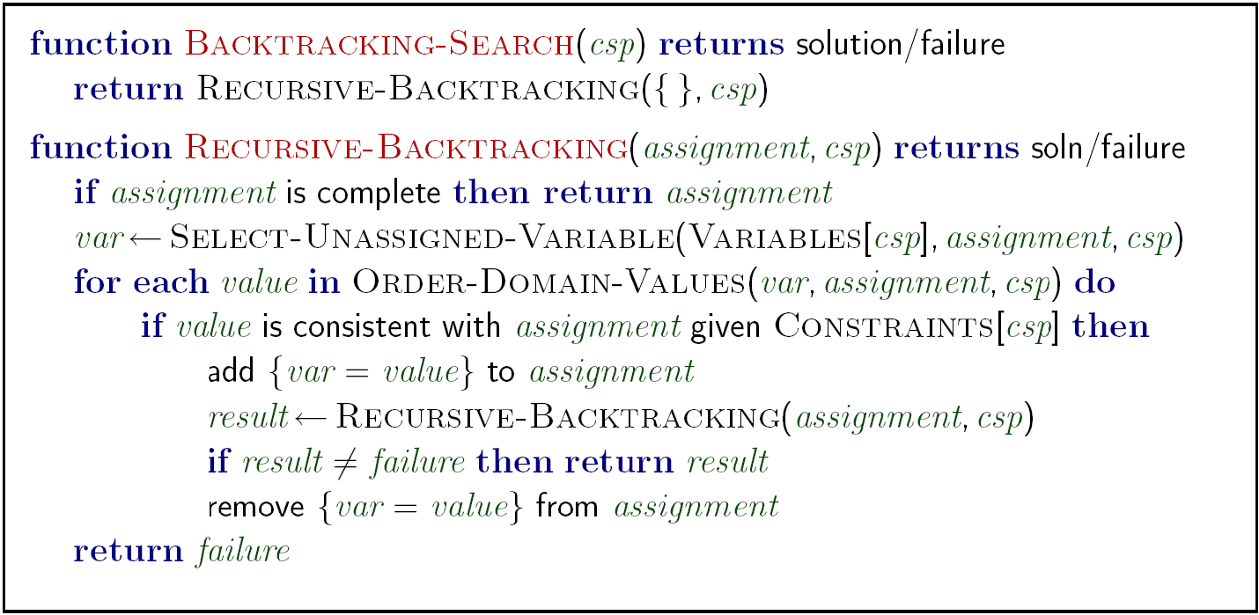
Backtracking Search
Backtracking = DFS + variable-ordering + fail-on-violation
What are the choice points?
[Demo: coloring -- backtracking]
Notes:
Demo:
CS188 javascript demos -> source -> exercises -> csps -> CSPs demos -> CSPs demos.html
Settings:
Graph = Simple
Algorithm = Backtracking
Ordering = None
Filtering = None

Slide 30

Improving Backtracking
General-purpose ideas give huge gains in speed
Ordering:
Which variable should be assigned next?
In what order should its values be tried?
Filtering: Can we detect inevitable failure early?
Structure: Can we exploit the problem structure?

Slide 31

Filtering

Slide 32
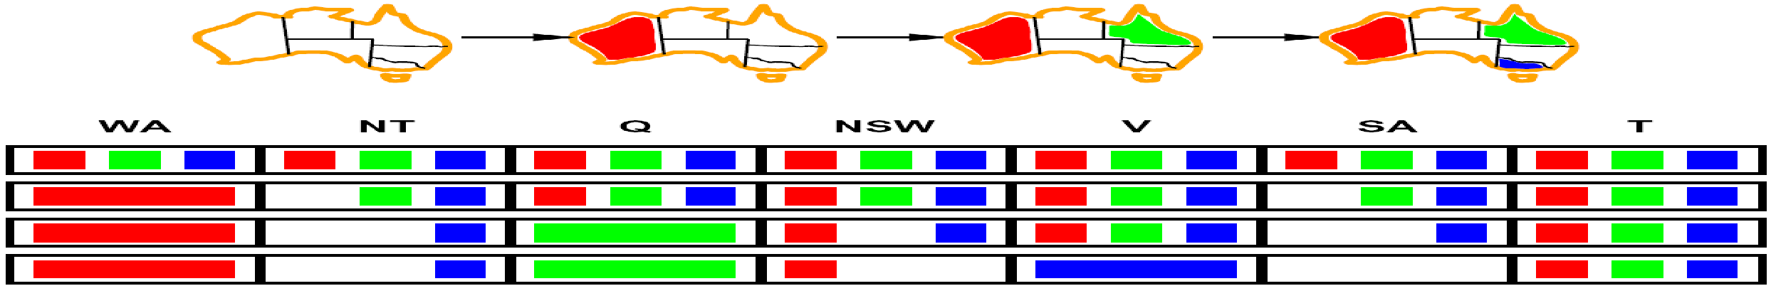
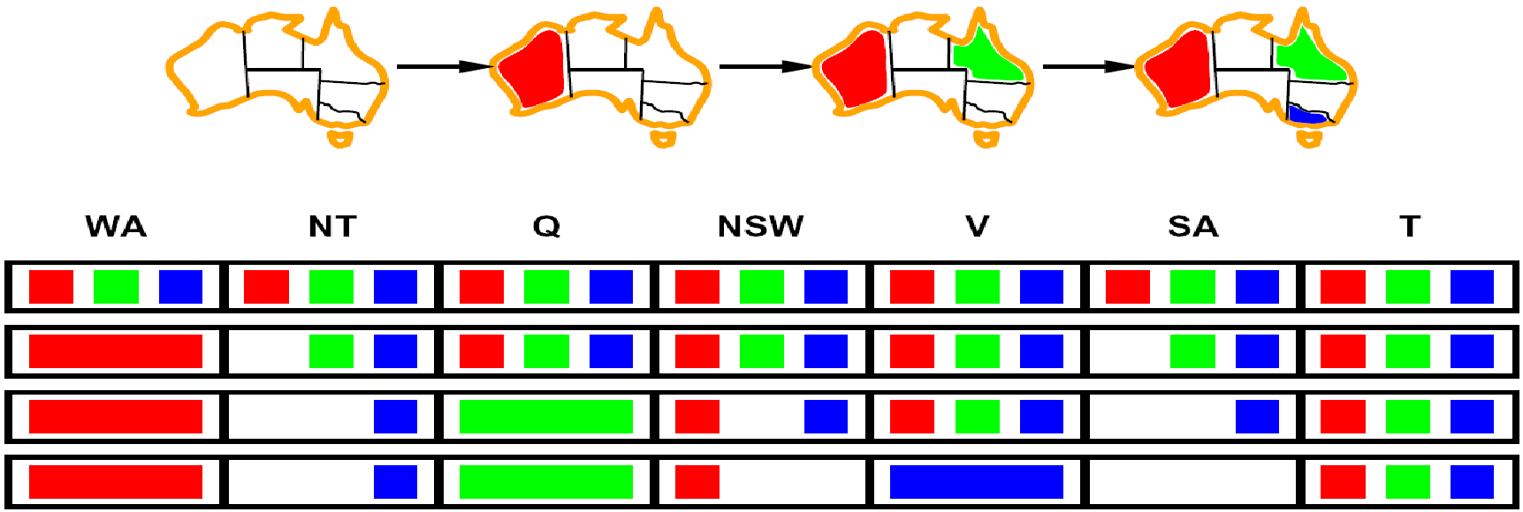
Filtering: Forward Checking
Filtering: Keep track of domains for unassigned variables and cross off bad options
Forward checking: Cross off values that violate a constraint when added to the existing assignment
WA
NT
Q
SA
NSW
V
[Demo: coloring -- forward checking]
Notes:
Demo:
CS188 javascript demos -> source -> exercises -> csps -> CSPs demos -> CSPs demos.html
Settings:
Graph = Simple
Algorithm = Backtracking
Ordering = None
Filtering = Forward Checking

Slide 33
Video of Demo Coloring – Backtracking with Forward Checking

Slide 34
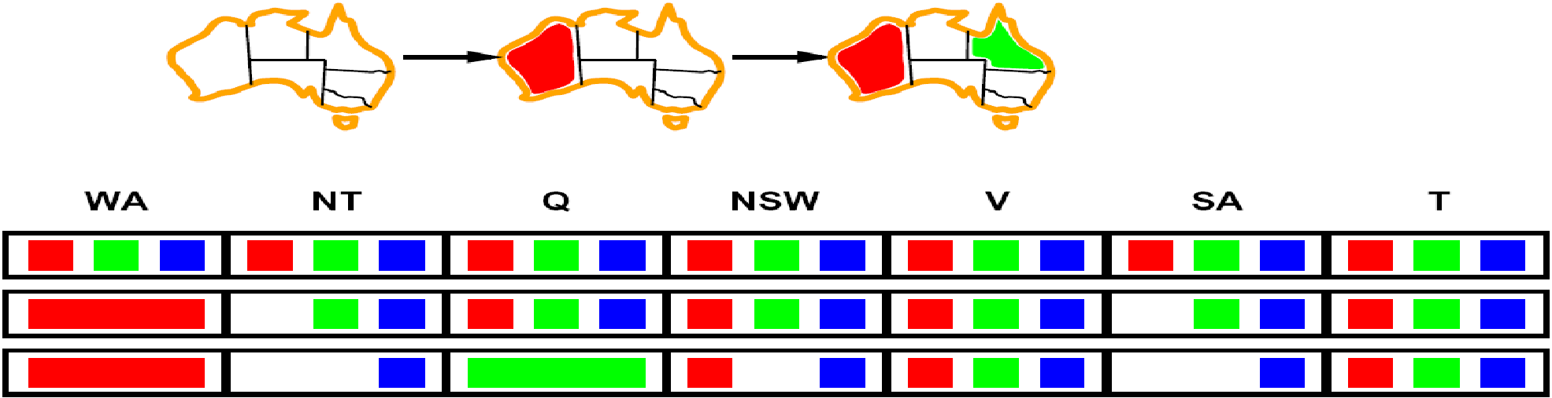
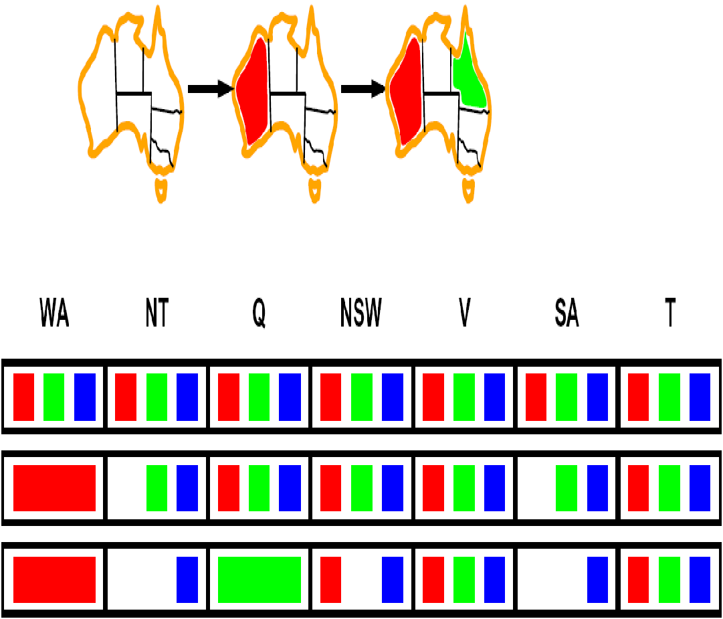
Filtering: Constraint Propagation
Forward checking propagates information from assigned to unassigned variables, but doesn't provide early detection for all failures:
NT and SA cannot both be blue!
Why didn’t we detect this yet?
Constraint propagation: reason from constraint to constraint
NT
Q
WA
SA
NSW
V

Slide 35
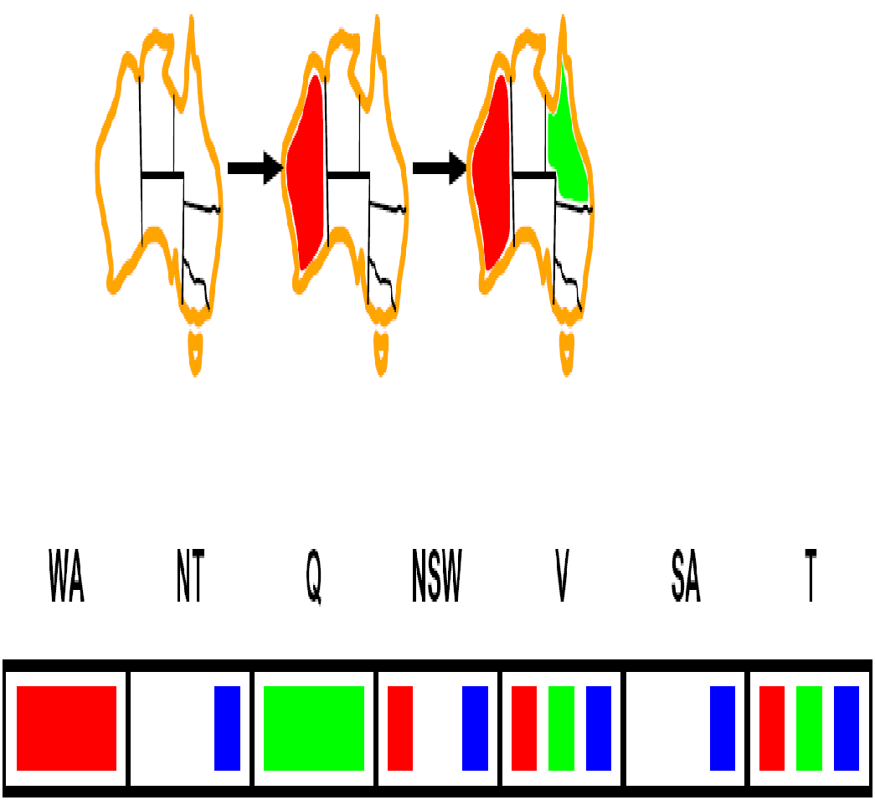
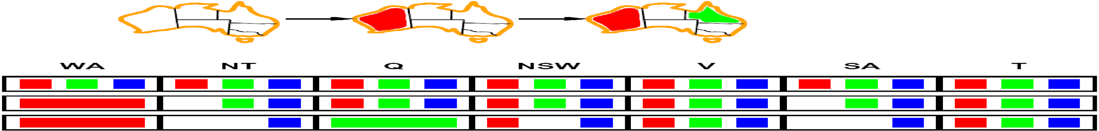


Consistency of A Single Arc
An arc X → Y is consistent iff for every x in the tail there is some y in the head which could be assigned without violating a constraint
Forward checking: Enforcing consistency of arcs pointing to each new assignment
NT
Q
WA
SA
NSW
V
Delete from the tail!

Slide 36

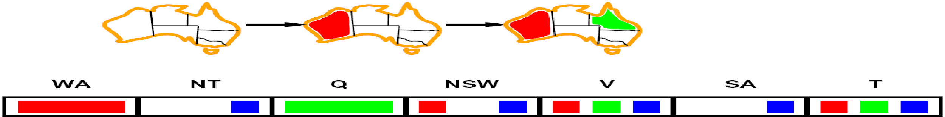
Arc Consistency of an Entire CSP
A simple form of propagation makes sure all arcs are consistent:
Important: If X loses a value, neighbors of X need to be rechecked!
Arc consistency detects failure earlier than forward checking
Can be run as a preprocessor or after each assignment
What’s the downside of enforcing arc consistency?
NT
Q
WA
SA
NSW
V
Remember: Delete from the tail!

Slide 37
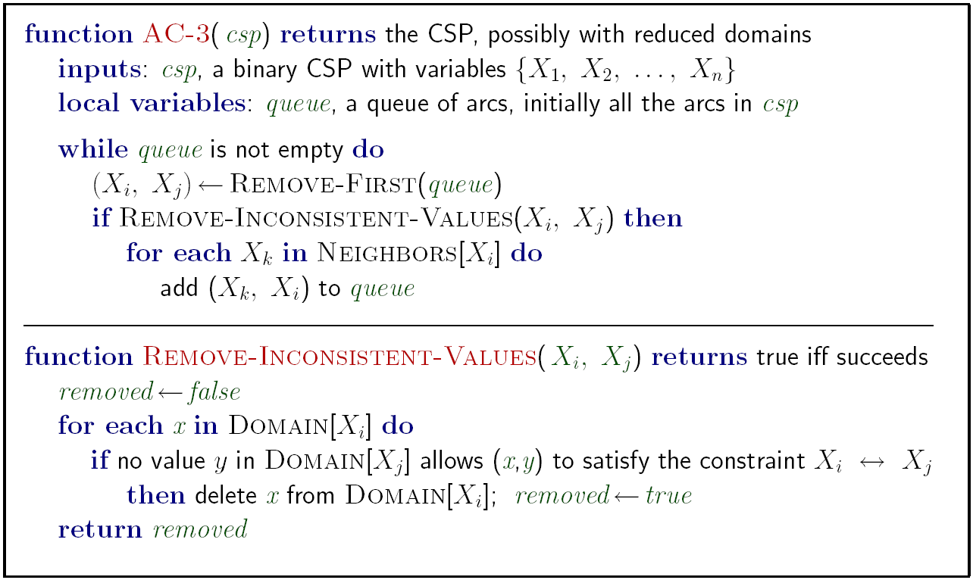
Enforcing Arc Consistency in a CSP
Runtime: O(n²d³), can be reduced to O(n²d²)
… but detecting all possible future problems is NP-hard – why?
[Demo: CSP applet (made available by aispace.org) -- n-queens]
Notes:
Auto-consistency (note initially nothing gets deleted/pruned since there are consistent options for all constraints for initial variable domains)
Flashes whenever something needs to be re-checked

Slide 38
Video of Demo Arc Consistency – CSP Applet – n Queens

Slide 39
Limitations of Arc Consistency
After enforcing arc consistency:
Can have one solution left
Can have multiple solutions left
Can have no solutions left (and not know it)
Arc consistency still runs inside a backtracking search!
What went wrong here?
[Demo: coloring -- forward checking]
[Demo: coloring -- arc consistency]
Notes:
Demo:
CS188 javascript demos -> source -> exercises -> csps -> CSPs demos -> CSPs demos.html
Settings:
Graph = Complex
Algorithm = Backtracking
Ordering = None
Filtering = Forward Checking (first) / Arc Consistency (second)

Slide 40
Video of Demo Coloring – Backtracking with Forward Checking – Complex Graph

Slide 41
Video of Demo Coloring – Backtracking with Arc Consistency – Complex Graph

Slide 42

Ordering

Slide 43


Ordering: Minimum Remaining Values
Variable Ordering: Minimum remaining values (MRV):
Choose the variable with the fewest legal left values in its domain
Why min rather than max?
Also called “most constrained variable”
“Fail-fast” ordering

Slide 44
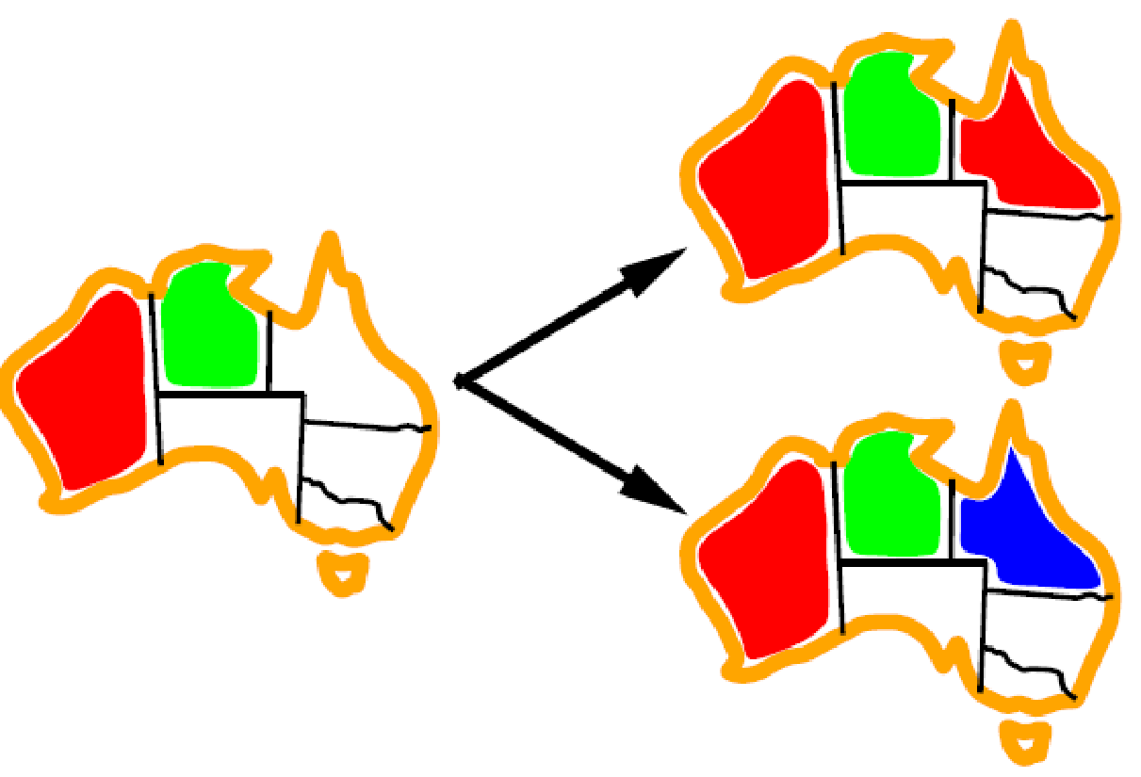

Ordering: Least Constraining Value
Value Ordering: Least Constraining Value
Given a choice of variable, choose the least constraining value
I.e., the one that rules out the fewest values in the remaining variables
Note that it may take some computation to determine this! (E.g., rerunning filtering)
Why least rather than most?
Combining these ordering ideas makes
1000 queens feasible
[Demo: coloring – backtracking + AC + ordering]
Notes:
Demo:
CS188 javascript demos -> source -> exercises -> csps -> CSPs demos -> CSPs demos.html
Settings:
Graph = Complex
Algorithm = Backtracking
Ordering = MRV
Filtering = Forward Checking
Solves already without any need for backtracking
Note: need a bigger problem to illustrate relevance of backtracking+AC+MRV+MCV

Slide 45
Demo: Backtracking + AC + Ordering

Slide 47
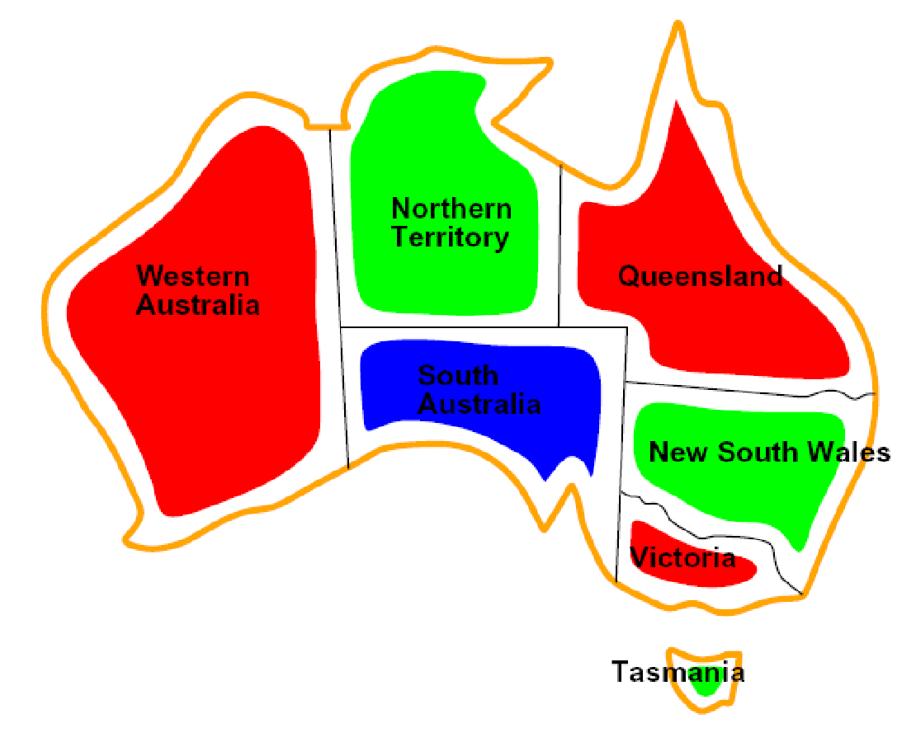
Constraint Satisfaction Problems
Standard search problems:
State is a “black box”: arbitrary data structure
Goal test can be any function over states
Successor function can also be anything
Constraint satisfaction problems (CSPs):
A special subset of search problems
State is defined by variables X_{i} with values from a domain D (sometimes D depends on i)
Goal test is a set of constraints specifying allowable combinations of values for subsets of variables
Simple example of a formal representation language
Allows useful general-purpose algorithms with more power than standard search algorithms

Slide 48

Degree Heuristic
Tie-breaker among MRV variables
Degree heuristic:
Choose the variable participating in the most constraints on remaining variables
Why most rather than fewest constraints?

Slide 49
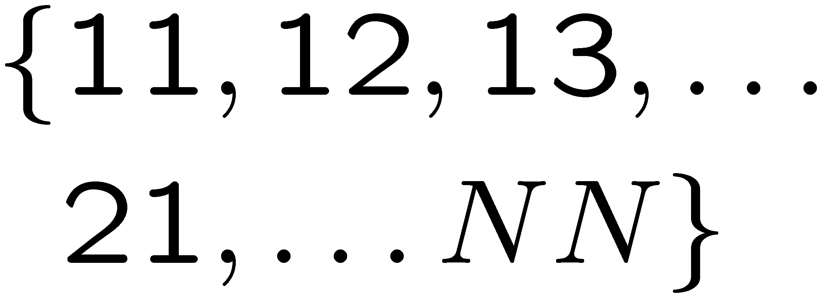
Example: N-Queens
Formulation 1.5:
Variables:
Domain:
Constraints:
… there’s an even better way! What is it?

Slide 50
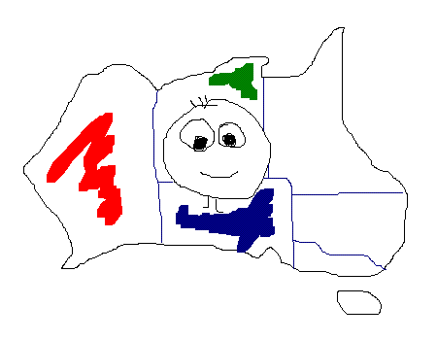
5 Minute Break
Courtesy of Dan Gillick

Slide 51
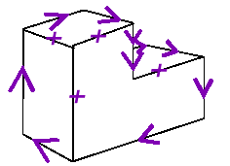
Waltz on Simple Scenes
Assume all objects:
Have no shadows or cracks
Three-faced vertices
“General position”: no junctions change with small movements of the eye.
Then each line on image is one of the following:
Boundary line (edge of an object) (→) with right hand of arrow denoting “solid” and left hand denoting “space”
Interior convex edge (+)
Interior concave edge (-)

Slide 52
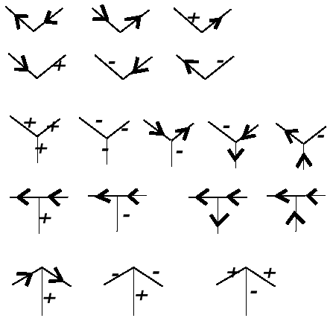
Legal Junctions
Only certain junctions are physically possible
How can we formulate a CSP to label an image?
Variables: vertices
Domain: junction labels
Constraints: both ends of a line should have the same label
x
(x,y) in
,
, …
y

Slide 53
Improving Backtracking
General-purpose ideas can give huge gains in speed:
Which variable should be assigned next?
In what order should its values be tried?
Can we detect inevitable failure early?
Can we take advantage of problem structure?

Slide 54


Forward Checking
NT
Q
WA
SA
NSW
V
Idea: Keep track of remaining legal values for unassigned variables (using immediate constraints)
Idea: Terminate when any variable has no legal values
[demo: forward checking animation]

Slide 55

Constraint Propagation
NT
Q
WA
SA
NSW
V
Forward checking propagates information from assigned to adjacent unassigned variables, but doesn't detect more distant failures:
NT and SA cannot both be blue!
Why didn’t we detect this yet?
Constraint propagation repeatedly enforces constraints (locally)

Slide 56
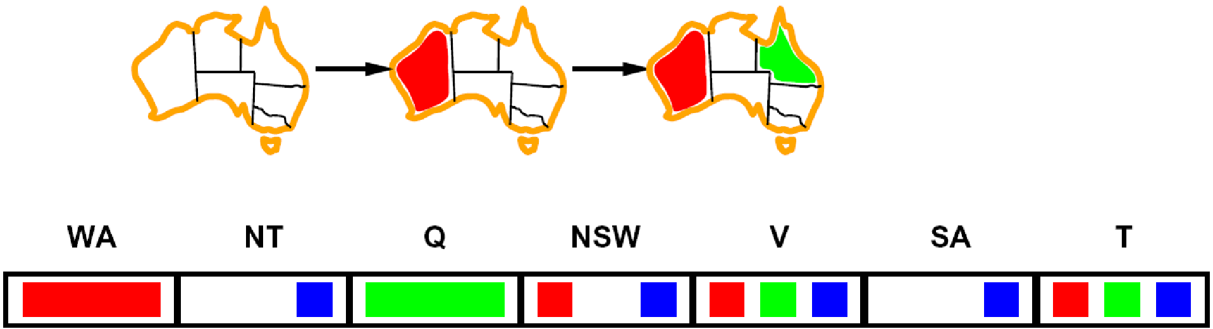
Arc Consistency
NT
Q
WA
SA
NSW
V
Simplest form of propagation makes each arc consistent
X → Y is consistent iff for every value x there is some allowed y
If X loses a value, neighbors of X need to be rechecked!
Arc consistency detects failure earlier than forward checking
What’s the downside of arc consistency?
Can be run as a preprocessor or after each assignment

Slide 57
Arc Consistency
Runtime: O(n²d³), can be reduced to O(n²d²)
… but detecting all possible future problems is NP-hard – why?
[demo: arc consistency animation]

Slide 58
Limitations of Arc Consistency
After running arc consistency:
Can have one solution left
Can have multiple solutions left
Can have no solutions left (and not know it)

